Slide 1
Database Key Components Review

Slide 2
Entity Relationship Model
Entity type
Collection of entities that share common properties or characteristics
STUDENT, COURSE, FACULTY
We model Entity types in the ER model, not entity instances
Relationship Type
A relationship type is a meaningful association between (or among) entity types
a collection of relationships that share common properties or characteristics
e.g., STUDENT registers for COURSE_OFFERING

Slide 3
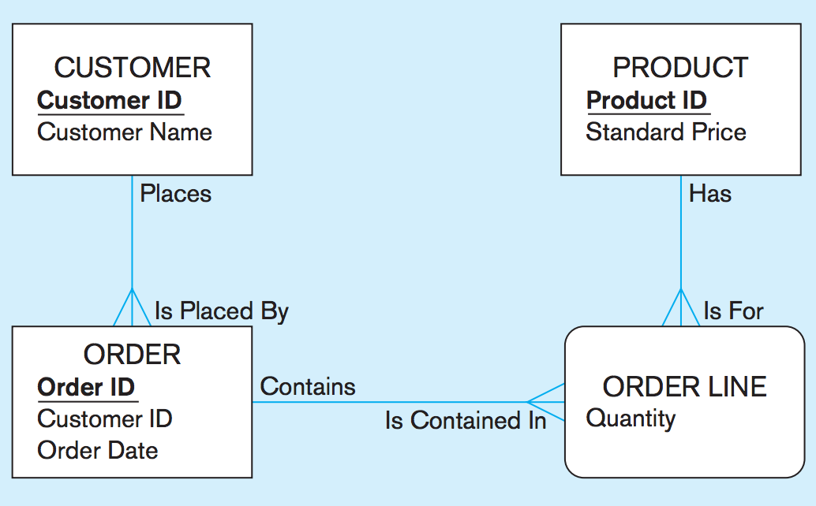
Entity Relationship Model

Slide 4




Cardinality Constraints
Mandatory One
Optional One
Mandatory Many
Optional Many
If the minimum cardinality is zero, participation is optional; if the minimum cardinality is one, participation is mandatory
Cardinality notation on both side of the relationship (bidirectional)
Notes:
vertical bar represent 1, and circle represent 0
The symbol closest to the entity is the maximum cardinality

Slide 5
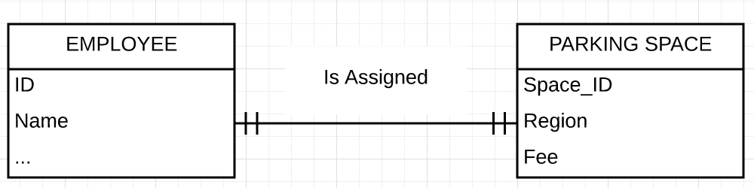
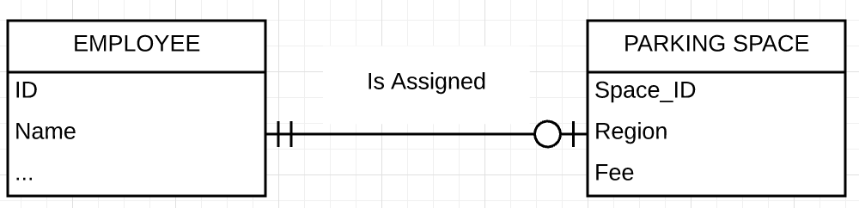
Cardinality Constraint
One-to-One relationship
Employee and Parking Space cannot exist without being associated to each other
Parking Space cannot exist without being associated to an Employee

Slide 6
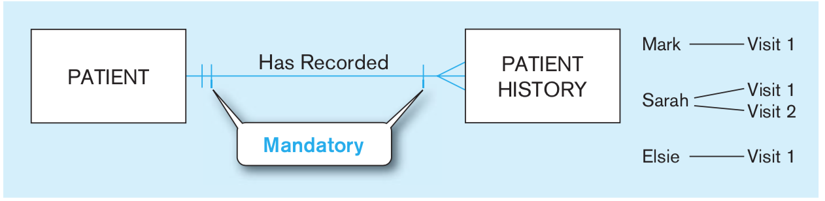
Cardinality Constraint
One-to-Many relationship
One patient can have many patient history records
One patient history record belongs to one patient
We also say in the above diagram that as soon as we keep a record for a patient, we also fill in a corresponding patient history record

Slide 7
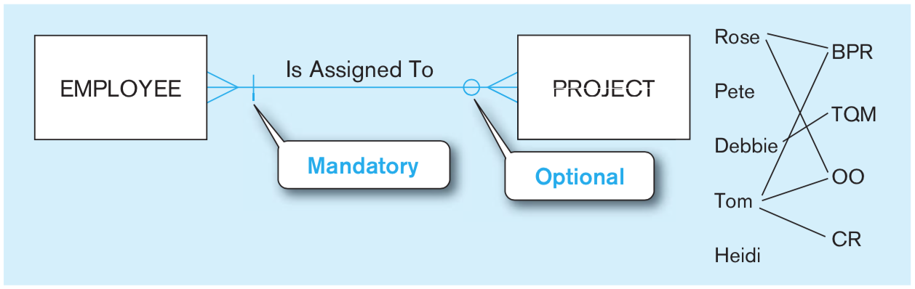
Cardinality Constraints
Many-to-Many relationship
One employee can be assigned to many projects
One project can have many employees assigned to it
Here, each project MUST have at least one employee assigned to it
An employee may or (optionally) may not be assigned any project

Slide 8
Relational Keys
Primary Key
Attribute or a combination of attributes that uniquely identifies each row in a relation
Allows efficient retrieval of a row of data from a relation
Designated by underlining the attribute name(s)
EMPLOYEE1(EmpID, Name, DeptName, Salary)

Slide 9

Relational Keys
Composite key
Primary key that consists of more than one attribute
DEPENDENT(EmpID, DependentName, DependentAge)
Foreign Key (Non-unique key)
Used to represent relationships between two table or relations
Attribute (possibly composite) in a relation that serves as the primary key of another relation
Notes:
We have relations/tables, have different type keys

Slide 10
Integrity Constraints
Rules limiting acceptable values and actions, to facilitate maintaining the accuracy and integrity of data.
Domain Constraints
Entity Integrity
Referential Integrity

Slide 11
Domain Constraints
Values that appear in a column of a relation must be from the same domain.
Domain
Set of values that may be assigned to an attribute.
Consists of domain name, meaning, data type, size (or length), and allowable values or allowable range

Slide 12
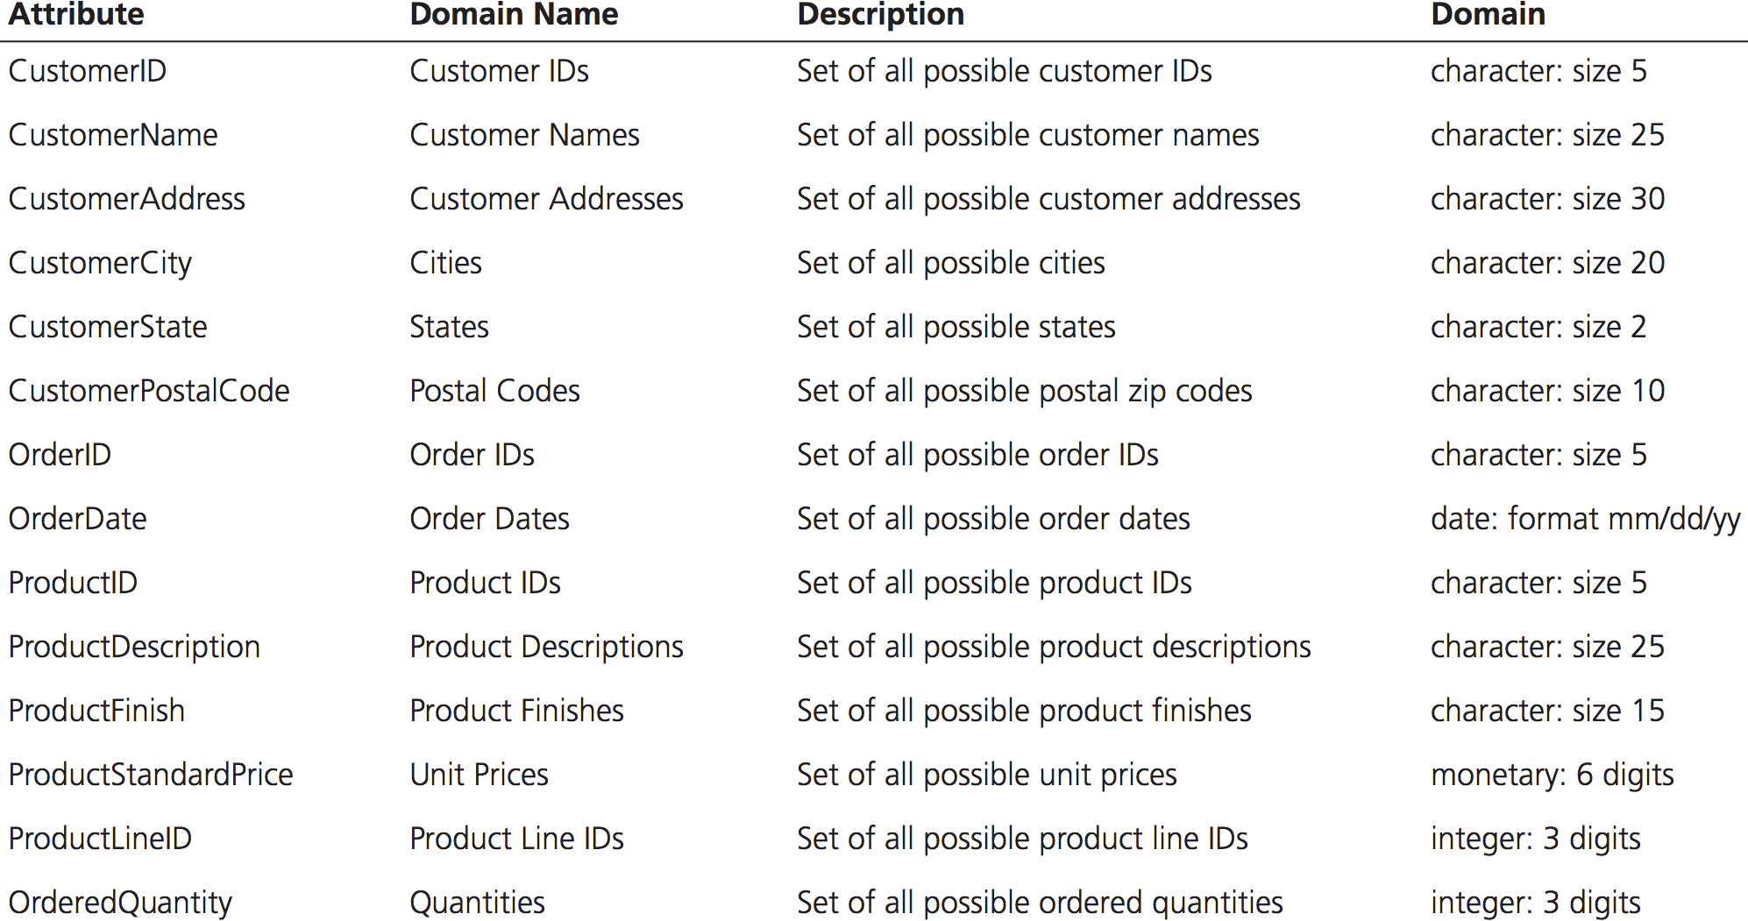
Domain Constraints

Slide 13
Entity Integrity Constraint
A rule that states that no primary key attribute (or component of a primary key attribute) may be null
Ensure that every relation has a primary key
Data values for that primary key are all valid
In particular, it guarantees that every primary key attribute is non-null
Null is a value that may be assigned to an attribute when no other value applies or when the applicable value is unknown.
We cannot compare two null values
Null is NOT the same as an empty string or zero

Slide 14
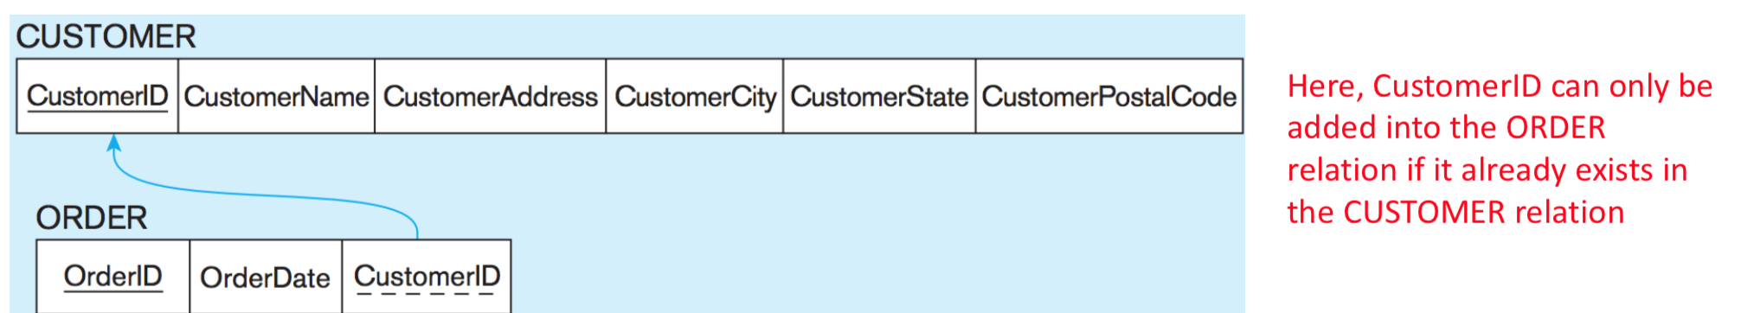
Referential Integrity Constraint
If there is a foreign key in one relation, either each foreign key value must match a primary key value in another relation or the foreign key value must be null
Represented by an arrow from foreign key towards associated primary key
Notes:
Employee, and parking space. Not every parking space is assigned to an employee

Slide 15
Referential Integrity Constraint
Null Foreign Keys
Mandatory associations between two tables cannot allow null foreign keys
For example, if we want to enforce that each Order needs to be associated to a Customer, then, the CustomerID in ORDER cannot be null
Null/non-null constraint can be defined in database implementation

Slide 16
Referential Integrity Constraint
Deleting Records in the “master” table
Different rules can apply when deleting a record from the master table that has an associated record
Consider what should happen if we delete a record from Customer table who already has an order in the Order table
Should we prevent the deletion of such a record until the order details has been deleted first
Should we allow deletion of the customer and cascade the deletion of the order
Should we allow deletion of the customer and set the CustomerID in the Order table to null

Slide 17
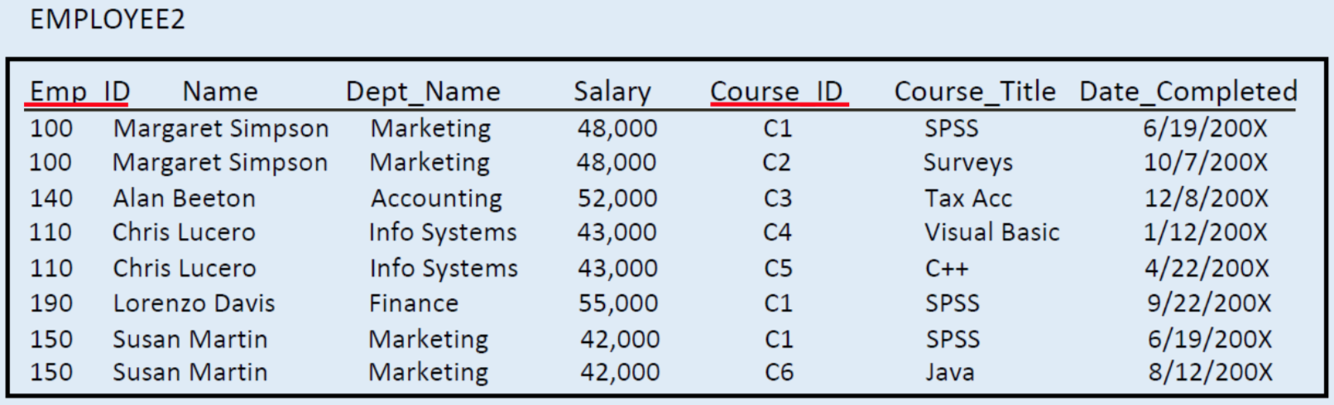
Normalization
Normalization: The process of decomposing relations with anomalies to produce smaller, well-structured relations;
A denormalized table:

Slide 18
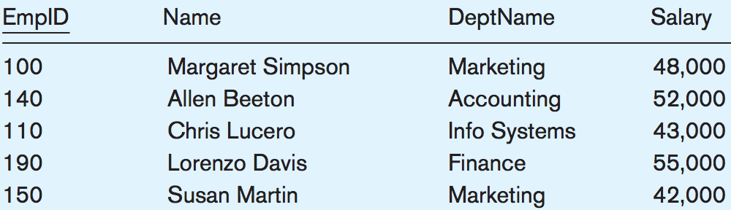
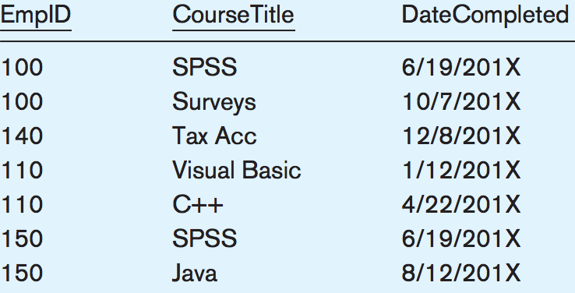
After the Normalization
Usually, a normalized table contains only one business object

